Slide 1
Javascript events
IN712 Web 3
Notes:
Imagine an interface where the only way to find out whether a key on
the keyboard is being pressed is to read the current state of that key.
To be able to react to keypresses, you would have to constantly read the
key’s state so that you’d catch it before it’s released again. It would be
dangerous to perform other time-intensive computations since you might
miss a keypress.
That is how such input was handled on primitive machines. A step up
would be for the hardware or operating system to notice the keypress
and put it in a queue. A program can then periodically check the queue
for new events and react to what it finds there.
Of course, it has to remember to look at the queue, and to do it
often, because any time between the key being pressed and the program
noticing the event will cause the software to feel unresponsive. This
approach is called polling. Most programmers avoid it whenever possible.
A better mechanism is for the underlying system to give our code a
chance to react to events as they occur. Browsers do this by allowing us
to register functions as handlers for specific events.

Slide 2
JavaScript Events
A JavaScript event is an occurrence that can be detected by JavaScript
Many events are initiated by user actions but some events are generated by the browser itself
We say then that an event is triggered and then it can be caught by JavaScript functions, which then do something in response
From inception, JavaScript allowed events to be specified right in the HTML markup with hooks to the JavaScript code (it still can)
This mechanism was popular in the 1990s and 2000s because it worked
As more powerful frameworks were developed, and website best practices were refined, this original mechanism was supplanted by the listener approach

Slide 3
Types of events
Mouse events: mouse movement, clicking, double-clicking, dragging
Keyword events: a keyboard press, depress
Form events: when something in the form changes
Mutation events: when the DOM nodes are modified
Touch events: when the user touches the sensor
Error events: when an error occurs
Frame events: are the events related to the browser frame that contains your web page (For instance, when the document loads)

Slide 4
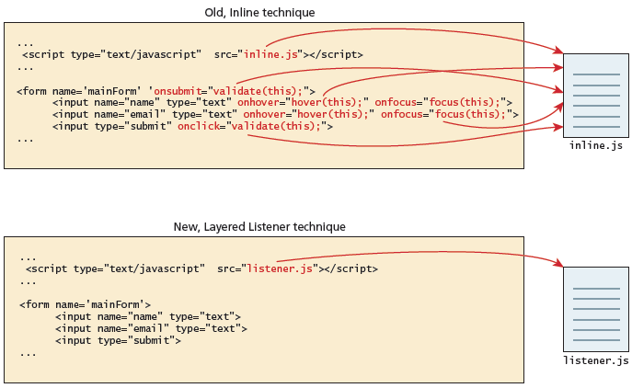
Connecting code to events - old and new technique comparison

Slide 5
In line event handler
JavaScript events allow the programmer to react to user interactions
Inline JavaScript calls are intuitive
In the example the HTML attribute onclick is used to attach a handler to that event (event handler)
When the user clicks the <div>, the event is triggered and the alert is shown
The problem with this type of programming is that the HTML markup and the corresponding JavaScript logic are woven together
This reduces the ability of designers to work separately from programmers, and generally complicates maintenance of applications
The better way to program this is to remove the JavaScript from the HTML

Slide 6
Object property event handler
The design principle of layers is a proven way of increasing maintainability and simplifying markup.
The problem with the inline handler approach is that it does not make use of layers; that is, it does not separate content from behavior.
A better way of attaching an event handler to an event is using event related properties of the HTML element
It’s main limitation is that you can only register one event listener for a single event

Slide 7

Listener approach event handler
The standard technique for listening for events
The only approach which is warranted to work in future browser versions
It’s biggest advantage is that you can register multiple event listeners for a single event on a single element

Slide 8
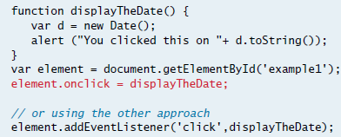
Listening to an event with a function

Slide 9

Listening to an event with an anonymous function

Slide 10
Propagation
Event handlers registered on nodes with children will also receive some events that happen in the children.
If a button inside a paragraph is clicked, event handlers on the paragraph will also receive the click event
But if both the paragraph and the button have a handler, the more specific handler—the one on the button—gets to go first.
The event is said to propagate outward, from the node where it happened to that node’s parent node and on to the root of the document.
Finally, after all handlers registered on a specific node have had their turn, handlers registered on the whole window get a chance to respond to the event.

Slide 11

Event object
No matter which type of event we encounter, they are all DOM event objects and the event handlers associated with them can access and manipulate them
Typically we see the events passed to the function handler as a parameter named e

Slide 12
Event object
These objects have many properties and methods.
Many of these properties are not used
But several key properties and methods of the event object are worth knowing
Bubbles: The bubbles property is a Boolean value. If an event’s bubbles property is set to true then there must be an event handler in place to handle the event or it will bubble up to its parent and trigger an event handler there
Cancelable. The Cancelable property is also a Boolean value that indicates whether or not the event can be cancelled
preventDefault. A cancelable default action for an event can be stopped using the preventDefault() method

Slide 13

A sample event handler function that prevents the default event
the preventDefault() method is a common practice when you want to send data asynchronously when a form is submitted, for example, since the default event of a form submit click is to post to a new URL (which causes the browser to refresh the entire page).

Slide 14
Example
What would happen if you click on the link?
<a href="https://developer.mozilla.org/">MDN</a>
<script>
var link = document.querySelector("a");
link.addEventListener("click", function(event) {
console.log("Nope.");
event.preventDefault();
});
</script>

Slide 15
Target property
Most event objects have a target property that refers to the node where they originated
It is possible to use the target property to cast a wide net for a specific type of event. For example, if you have a node containing a long list of buttons, it may be more convenient to register a single click handler on the outer node and have it use the target property to figure out whether a button was clicked, rather than register individual handlers on all of the buttons.
<button>A</button>
<button>B</button>
<button>C</button>
<script>
document.body.addEventListener("click", function(event) {
if (event.target.nodeName == "BUTTON")
console.log("Clicked", event.target.textContent);
});
</script>

Slide 16
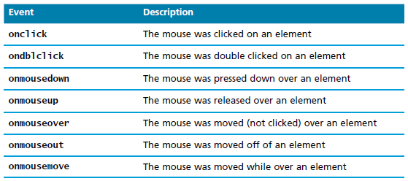
Mouse events
Mouse events are defined to capture a range of interactions driven by the mouse
These can be further categorized as mouse click and mouse move events

Slide 17
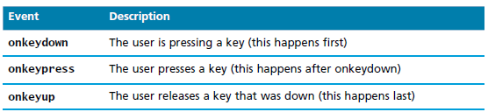
Keyboard events
When a key on the keyboard is pressed, your browser fires a "keydown“ event.
When it is released, a "keyup" event fires.
These events are most useful within input fields.
We could for example validate an email address, or send an asynchronous request for a dropdown list of suggestions with each key press

Slide 18
Keyboard events example
<p>This page turns violet when you hold the V key.</p>
<script>
addEventListener("keydown", function(event) {
if (event.keyCode == 86)
document.body.style.background = "violet";
});
addEventListener("keyup", function(event) {
if (event.keyCode == 86)
document.body.style.background = "";
});
</script>
The code example looks at the keyCode property of the event object.
This is how you can identify which key is being pressed or released.
For letter and number keys, the associated key code will be the Unicode character code associated with the (uppercase) letter or number printed on the key.
Notes:
The code example looks at the keyCode property of the event object.
This is how you can identify which key is being pressed or released.
Unfortunately, it’s not always obvious how to translate the numeric key
code to an actual key.
For letter and number keys, the associated key code will be the Unicode
character code associated with the (uppercase) letter or number printed
on the key. The charCodeAt method on strings gives us a way to find this
code.
console.log("Violet".charCodeAt(0));
// → 86

Slide 19
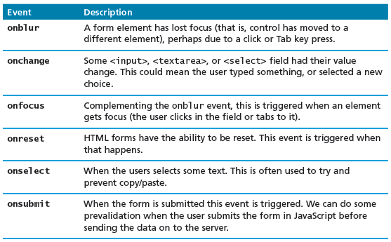
Form events
Forms are the main means by which user input is collected and transmitted to the server
The events triggered by forms allow us to do some timely processing in response to user input
The most common JavaScript listener for forms is the onsubmit event

Slide 20
Frame events
Frame events are the events related to the browser frame that contains your web page
The most important event is the onload event, which tells us an object is loaded and therefore ready to work with.
In fact, every nontrivial event listener you write requires that the HTML be fully loaded
However, a problem can occur if the JavaScript tries to reference a particular <div> in the HTML page that has not yet been loaded
If the code attempts to set up a listener on this not-yet-loaded <div>, then an error will be triggered
For this reason it is common practice to use the window.onload event to trigger the execution of the rest of the page’s scripts
<!DOCTYPE html>
<html>
<head>
<title>DOM</title>
<script>
var button = document.getElementById("btnTest")
</script>
</head>
<body>
<p>
<input type="button" onclick="objectDemo();“ id="btnTest"/>
</p>
</body>
</html>
Problem! btnTest does not exist yet as the JavaScript engine of the browser is parsing the script element

Slide 21

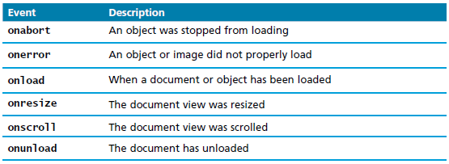
Frame events

Slide 22
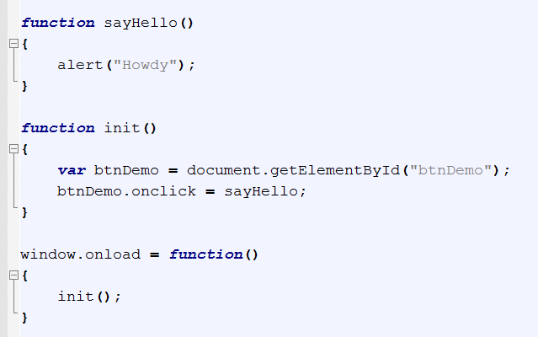
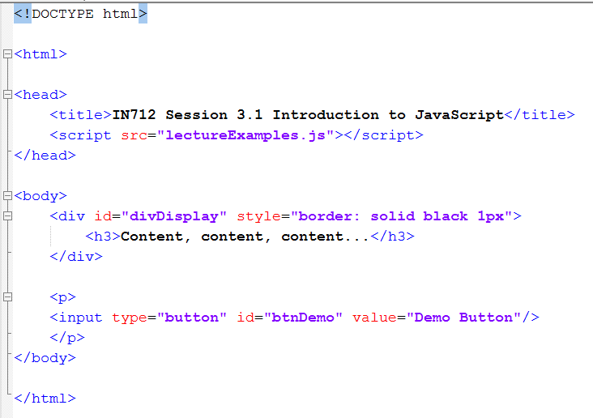
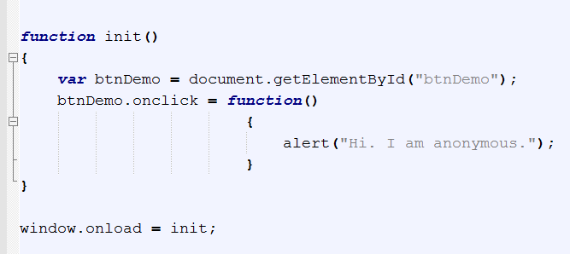
window.onload Example

Slide 23
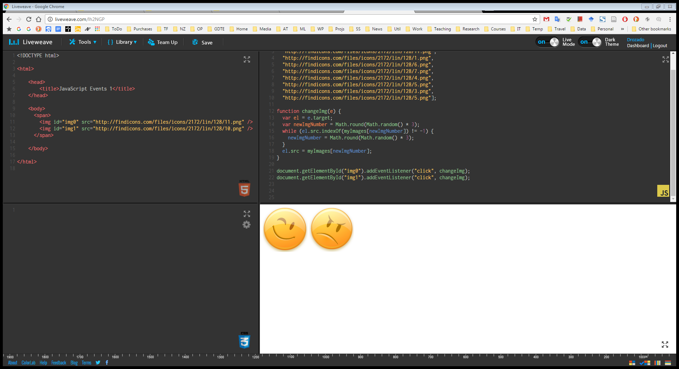
Events Demo 1

Slide 24
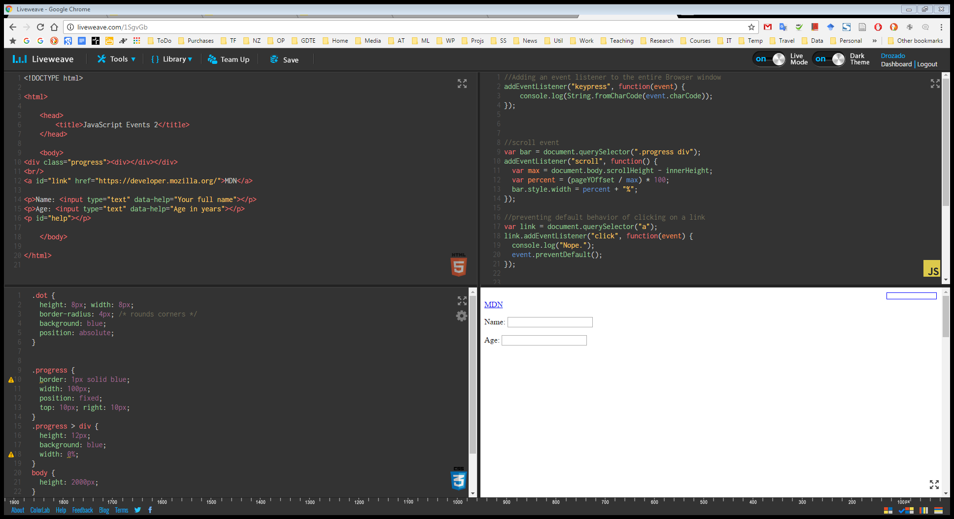
Events Demo 2

Slide 25
HTML5 Media
The web started up as a text delivery system
Users demand for media content preceded the emergence of plug‐ins and third‐party applications that were designed to do things browsers normally didn’t, such as playing video and audio
Plug‐ins solved a particular problem, but they weren’t without their faults—the largest being the need for so many of them.
A wide variety of music and video formats were available, and certain plug‐ins would only play certain formats.
Stability was also an issue because a malfunctioning plug‐in could crash the browser.

Slide 26
HTML5 Media
Many people believe the browser should have the built‐in capability for playing video and audio
So the people developing the HTML5 specification included two new tags, <video> and <audio>, for that express purpose
video and audio are very similar; in fact, the primary difference between the two elements is that <audio/> elements have no playback area for visual content.
This discussion focuses primarily on video but the same concepts can be applied to audio
Before HTML5, embedding video within a web page was cumbersome because it required you to use no less than three elements for the video to work in all browsers.
With HTML5, however, all you need is the <video/> element:
<audio src="horse.mp3"></audio>
<video src="horse.mp3"></video>

Slide 27

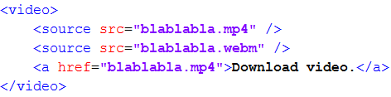
HTML5 Media
You can add some content inside the <video> element which will only display in browsers that do not support the <video> element
Often you will not use the src attribute. Instead you will include several sources within your <video> element to support different browser support for different video formats

Slide 28

HTML5 Media
By default, videos do not display controls, but you can easily add the default controls by adding the controls attribute to the <video> element
You can also tell the browser to preload the video with the preload attribute
By default, the browser uses the first frame of the video as the poster of the video, the initial visual representation of the video. You can use the poster attribute to display a custom image for the video’s poster

Slide 29
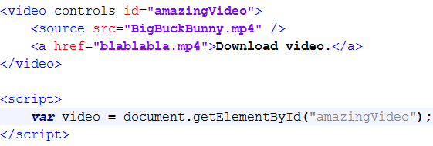
Scripting media
In the DOM, <video/> and <audio/> elements are HTMLMediaElement objects
the HTML5 specification defines an API for working with these objects.
You can retrieve an existing <video/> or <audio/> element in the page using any of the various methods for finding elements.

Slide 30
Media methods
Method name | description
canPlayType(mimeType) | Determines the likelihood that the browser can play media of the provided MIME type and/or codeccanPlayType(mimeType)
load() | Begins to load the media from the server
pause() | Pauses the media playback
play() | Begins or continues the playback of the media

Slide 31
Media properties
autoplay | Gets or sets the autoplay HTML attribute, indicating whether playback should automatically begin as soon as enough media is available
controls | Reflects the controls HTML attribute
currentTime | Gets the current playback time. Setting this property seeks the media to the new time.
duration | Gets the length of the media in seconds; zero if no media is available. Returns NaN if the duration cannot be determined
ended | Indicates whether the media element has ended playback
loop | Reflects the loop HTML attribute. Indicates whether the media element should start over when playback reaches the end
muted | Gets or sets whether the audio is muted
paused | Indicates whether the media is paused
playbackRate | Gets or sets the playback rate. 1.0 is normal speed.
poster | Gets or sets the poster HTML attribute
preload | Reflects the preload HTML element attribute
src | Gets or sets the src HTML attribute
volume | The audio volume. Valid values range from 0.0 (silent) to 1.0 (loudest).

Slide 32
Media events
Event Name | Description
abort | Fires when playback is aborted
canplay | Sent when enough data is available to play the media
canplaythrough | Indicates that the entire media can be played through without interruption
durationchange | The media’s metadata has changed, indicating a change in the media’s duration.
ended | Fires when playback completes
error | Sent when an error occurs
loadstart | Downloading has begun.
pause | Fires when playback is paused
playing | Sent when the media starts or resumes playing
progress | Downloading is in progress.
ratechange | Fires when the playback speed changes
seeked | Seeking has ended.
seeking | Fires when playback is moved to a new position
timeupdate | The currentTime property has changed.
volumechange | Either the volume property or muted property has changed.

Slide 33
Web workers
There are various things that can cause a script to start executing.
Reading a <script> tag is one such thing.
An event firing is another.
It is important to understand that even though events can fire at any time, no two scripts in a single document ever run at the same moment. If a script is already running, event handlers and pieces of code scheduled in other ways have to wait for their turn.
This is the reason why a document will freeze when a script runs for a long time.
The browser cannot react to clicks and other events inside the document because it can’t run event handlers until the current script finishes running.

Slide 34
Web workers
Some programming environments do allow multiple threads of execution to run at the same time.
Doing multiple things at the same time can be used to make a program faster. But when you have multiple actors touching the same parts of the system at the same time, thinking about a program becomes harder.
JavaScript programs that do only one thing at a time makes our lives easier.
For cases where you really do want to do some time-consuming thing in the background without freezing the page, browsers provide something called web workers.
A web worker is an isolated JavaScript environment that runs alongside the main program for a document and can communicate with it only by sending and receiving messages.

Slide 35
Web workers
For security reasons Chrome doesn't let you load web workers when running scripts from a local file.
For the provided demo illustrating the usage of web workers, close all your Google Chrome processes, and start Chrome again from the command prompt with the flag: --allow-file-access-from-files in order to be able to use web workers instantiated from local files

Slide 36
<!DOCTYPE html>
<html>
<head>
<title>JavaScript Workers Demo</title>
<script src="worker.js"> </script>
</head>
<body>
<a href=""> I am a link. Check whether you can interact with me during heavy computation</a>
<br/>
Number of computations to carry out:
<select id="val" name="numberOfComputationalCycles">
<option value="1000">1000</option>
<option value="2000">2000</option>
<option value="5000">5000</option>
<option value="10000">10000</option>
</select>
<br/>
<script>
function doHeavyComputationWithWorkers(){
var numberOfComputationalCycles = document.getElementById("val").value;
console.log("Carrying out " + numberOfComputationalCycles + " computational cycles with workers");
console.log("Notice that during the computation you can interact with elements in the page")
var squareWorker = new Worker("./worker.js");
squareWorker.addEventListener("message", function(event) {
console.log("The worker responded:", event.data);
});
squareWorker.postMessage(numberOfComputationalCycles);
};
function doHeavyComputationWithoutWorkers(){
var numberOfComputationalCycles = document.getElementById("val").value;
console.log("Carrying out " + numberOfComputationalCycles + " computational cycles without workers");
console.log("Notice that during the computation you cannot interact with elements in the page")
doHeavyComputation(numberOfComputationalCycles);
console.log("I'm Done!")
};
</script>
<input type="button" value="Heavy computation with workers" onclick=doHeavyComputationWithWorkers();>
<input type="button" value="Heavy computation without workers" onclick=doHeavyComputationWithoutWorkers();>
</body>
</html>
Notes:
The postMessage function sends a message, which will cause a "message"event to fire in the receiver. The script that created the worker sends and receives messages through the Worker object, whereas the worker talks to the script that created it by sending and listening directly on its global scope—which is a new global scope, not shared with the original script.

Slide 37
worker.js file
function fact(num)
{
if (num === 0)
{ return 1; }
else
{ return num * fact( num - 1 ); }
}
function doHeavyComputation(upperBound){
for (var i=1; i <= upperBound; i++){
for (var j=1; j <= upperBound; j++){
var r = Math.round(Math.random()*1000);
fact(r);
}
}
//console.log(r);
return r
}
addEventListener("message", function(event) {
re = doHeavyComputation(event.data);
postMessage("I'm Done!");
});
Notes:
The postMessage function sends a message, which will cause a "message"event to fire in the receiver. The script that created the worker sends and receives messages through the Worker object, whereas the worker talks to the script that created it by sending and listening directly on its global scope—which is a new global scope, not shared with the original script.

